Slide 1



A Comprehensive Study and Search for AI driven solutions of Tropical Storm Damages
Presented by Arnab Mukherjee & Debajyoti Maity

Slide 2
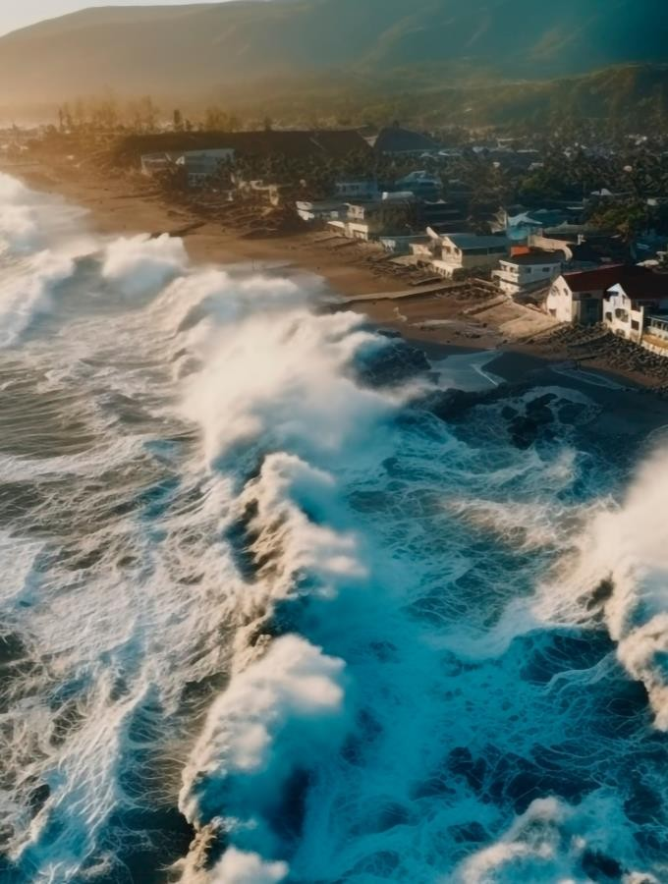
Contents
1
INTRODUCTION
2
DATA DESCRIPTION & EDA
3
METHODOLOGY
4
RESULTS AND DISCUSSTION

Slide 3
01
Introduction
Problem Statement :
Developing an AI-driven solution to detect and classify storm-damaged residential and commercial building to prompt Government actions.
Insurers seeking to assess and process claims related to storm damage.

Slide 4
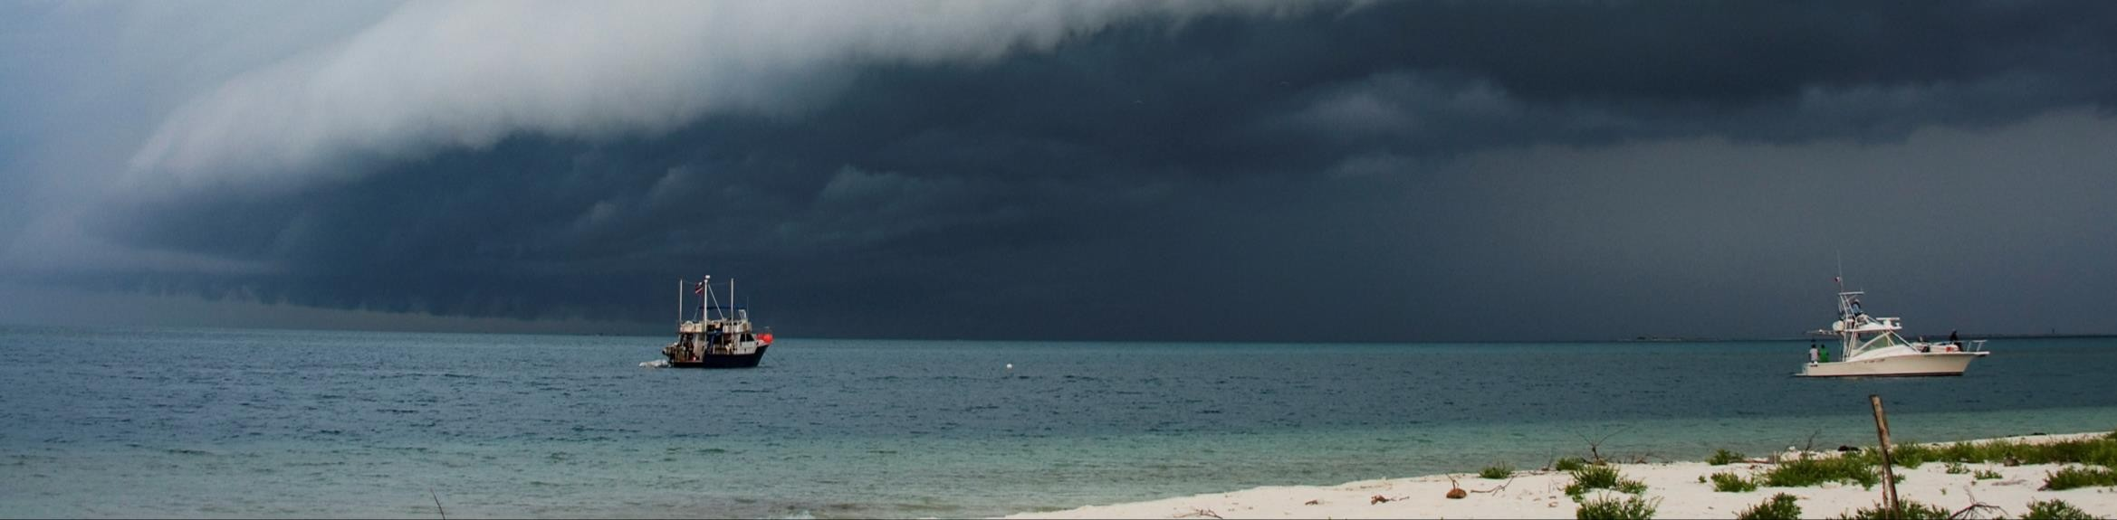
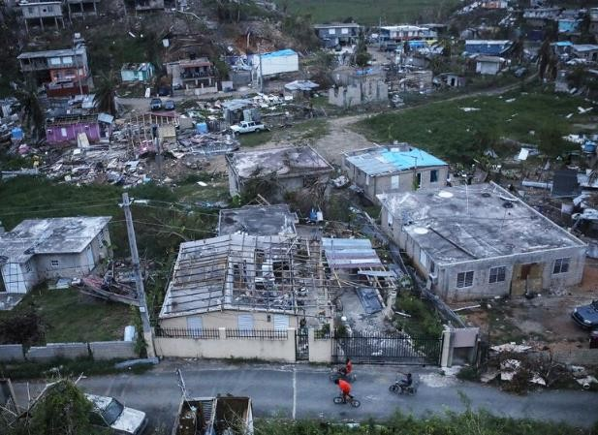
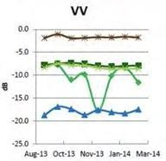
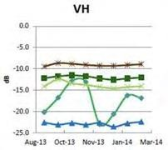
Analysis Region
For this challenge, we have selected a region over Puerto Rico which was devastated by hurricane Maria on September 20, 2017. The storm center crossed the southeast coast of Puerto Rico near Yabucoa with maximum winds at 135 knots.
Figure 2: Figure 2. Storm damage from Hurricane Maria in Puerto Rico. Credit: Mario Tama, Getty Images.

Slide 5
02
Dataset Description
The dataset contain 10719 images of pre event and post event images.
For our project purpose We includes 250 images. The original resolution of each image is 512×512 pixels.
Dataset contain pre event images of the hurricane Maria and Post event images.
Using LabelMe software we manually annotate the post event images into four classes .
Undamaged residential building
Damaged residential building
Undamaged commercial building
Damaged commercial building

Slide 6
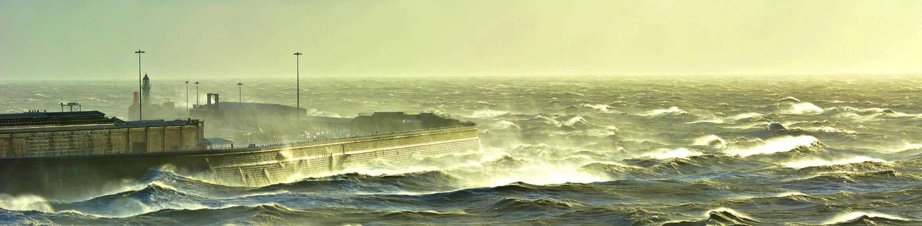
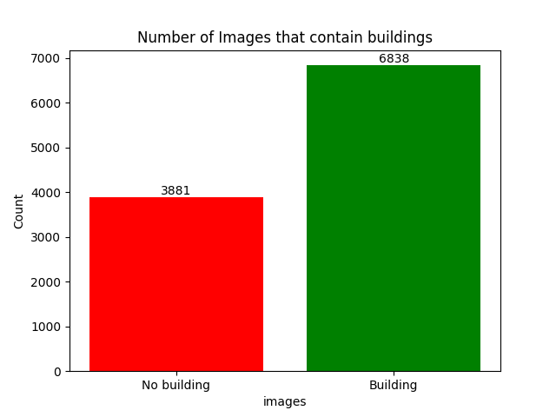

Slide 7
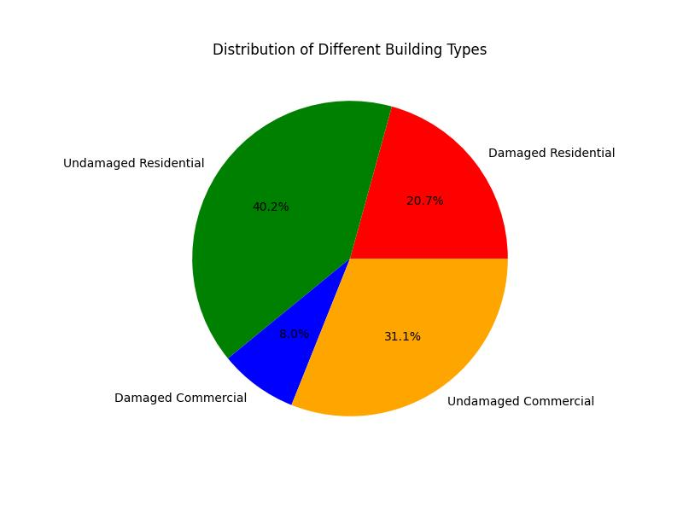
Damaged residential buildings:454
Undamaged residential buildings:880
Damaged Commercial buildings:176
Undamaged Commercial buildings:680

Slide 8
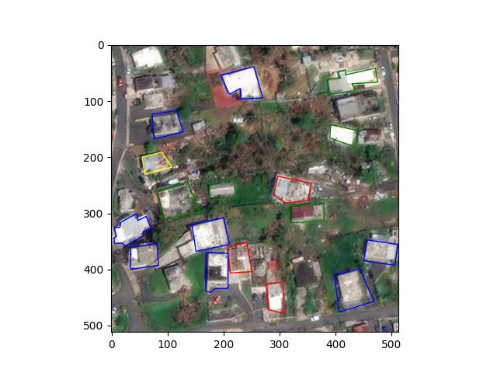
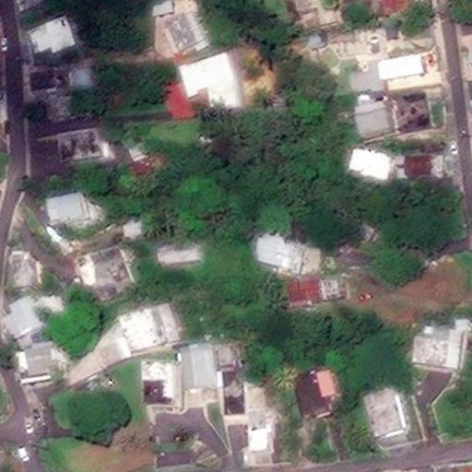
Pre Event Image
Post Event Image
"undamagedcommercialbuilding": "blue", "damagedcommercialbuilding": "red", "undamagedresidentialbuilding": "green", "damagedresidentialbuilding": "yellow"
Label -

Slide 9
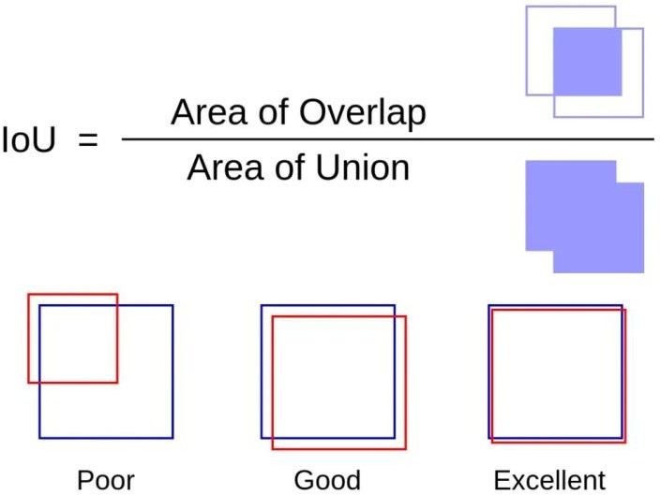
Data Preprocessing
Augmentation
Shear
Brightness
Exposure
Rotation
Training-603
Validation-50

Slide 10

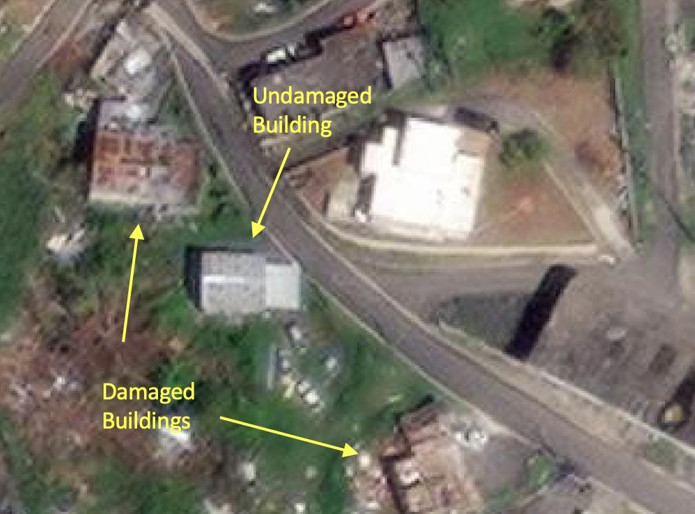

Slide 11
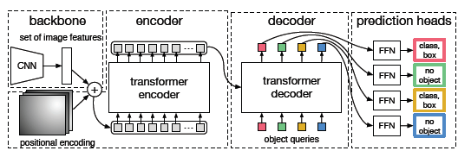
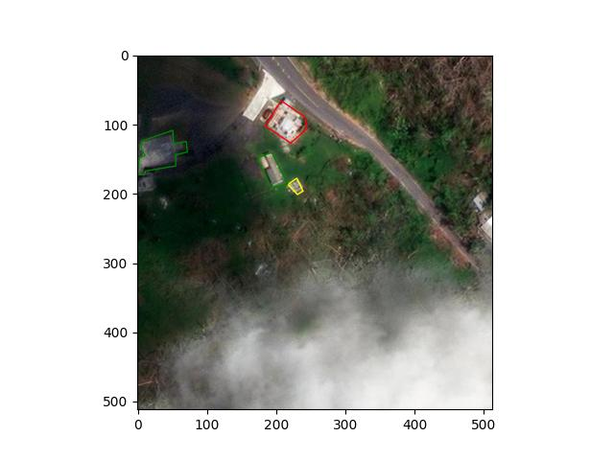
03
Methodology
Detection Transformer

Slide 13
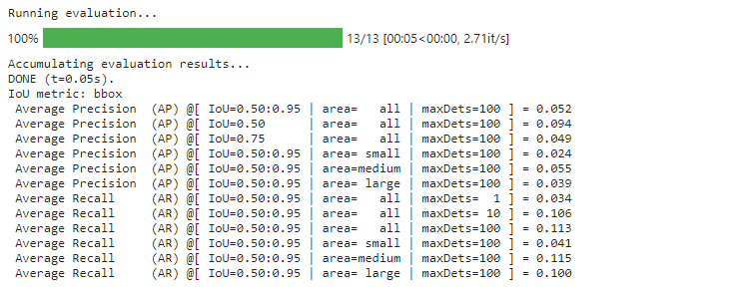
04
Result

Slide 14
Conclusion
We presented DETR, a new design for object detection systems based on transformers and bipartite matching loss for direct set prediction . Further we shall try for other object detection model.

